Slide 1

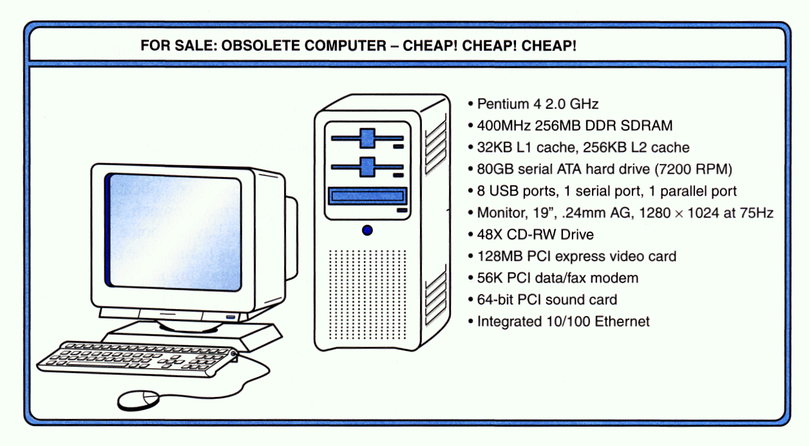
1.3 An Example System
7
Consider this advertisement:

Slide 2
1.3 An Example System
13
The microprocessor is the “brain” of the system. It executes program instructions. This one is a Pentium 4 (Intel) running at 2.0GHz.
A system bus moves data within the computer. The faster the bus the better. This one runs at 400MHz.

Slide 3
1.3 An Example System
14
Computers with large main memory capacity can run larger programs with greater speed than computers having small memories.
RAM is an acronym for random access memory. Random access means that memory contents can be accessed directly if you know its location.
Cache is a type of temporary memory that can be accessed faster than RAM.

Slide 4
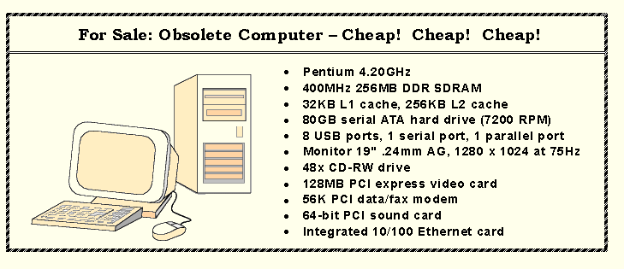
1.3 An Example System
15
This system has 256MB of (fast) synchronous dynamic RAM (SDRAM) . . .
… and two levels of cache memory, the level 1 (L1) cache is smaller and (probably) faster than the L2 cache. Note that these cache sizes are measured in KB.

Slide 5
1.3 An Example System
16
Hard disk capacity determines the amount of data and size of programs you can store.
This one can store 80GB. 7200 RPM is the rotational speed of the disk. Generally, the faster a disk rotates, the faster it can deliver data to RAM. (There are many other factors involved.)

Slide 6
1.3 An Example System
17
ATA stands for advanced technology attachment, which describes how the hard disk interfaces with (or connects to) other system components.
A CD can store about 650MB of data. This drive supports rewritable CDs, CD-RW, that can be written to many times.. 48x describes its speed.

Slide 7
1.3 An Example System
18
Ports allow movement of data between a system and its external devices.
This system has ten ports.

Slide 8
1.3 An Example System
19
Serial ports send data as a series of pulses along one or two data lines.
Parallel ports send data as a single pulse along at least eight data lines.
USB, Universal Serial Bus, is an intelligent serial interface that is self-configuring. (It supports “plug and play.”)

Slide 9
1.3 An Example System
20
System buses can be augmented by dedicated I/O buses. PCI, peripheral component interface, is one such bus.
This system has three PCI devices: a video card, a sound card, and a data/fax modem.

Slide 10
1.3 An Example System
21
The number of times per second that the image on a monitor is repainted is its refresh rate. The dot pitch of a monitor tells us how clear the image is.
This one has a dot pitch of 0.24mm and a refresh rate of 75Hz.
The video card contains memory and programs that support the monitor.

Slide 11
1.3 An Example System
22
Throughout the remainder of this book you will see how these components work and how they interact with software to make complete computer systems.
This statement raises two important questions:
What assurance do we have that computer components will operate as we expect?
And what assurance do we have that computer components will operate together?

Slide 12
1.4 Standards Organizations
23
There are many organizations that set computer hardware standards-- to include the interoperability of computer components.
Throughout this book, and in your career, you will encounter many of them.
Some of the most important standards-setting groups are . . .

Slide 13
1.4 Standards Organizations
24
The Institute of Electrical and Electronic Engineers (IEEE)
  Promotes the interests of the worldwide electrical engineering community.
  Establishes standards for computer components, data representation, and signaling protocols, among many other things.

Slide 14
1.4 Standards Organizations
25
The International Telecommunications Union (ITU)
  Concerns itself with the interoperability of telecommunications systems, including data communications and telephony.
National groups establish standards within their respective countries:
  The American National Standards Institute (ANSI)
  The British Standards Institution (BSI)

Slide 15
1.4 Standards Organizations
26
The International Organization for Standardization (ISO)
  Establishes worldwide standards for everything from screw threads to photographic film.
  Is influential in formulating standards for computer hardware and software, including their methods of manufacture.
Note: ISO is not an acronym. ISO comes from the Greek,
isos, meaning “equal.”

